Slide 1

Introduction to Python

Slide 2

Manishkumar R Solanki
Sr. Lecturer, Information Technology,
manish_ratilal2002@yahoo.com
SBMP

Slide 3
Students will be able to:
Describe the features of Python
Enlist applications of Python
Install and configure Python on Windows based machine
Write and execute “Hello World” program using python shell, text editor and IDE.

Slide 4
Let’s start with Python

Slide 5
Python
A general purpose, dynamic, high-level, and interpreted scripting programming language.
Simple, easy to learn and provision of lots of high-level data structures.
Supports multiple programming pattern, i.e. object-oriented, imperative, and functional(procedural) programming styles

Slide 6
History
Invented by Guido van Rossum in 1991 at CWI in Netherland.
The idea has been taken from the ABC programming language.
Name is picked up from the popular BBC comedy show , "Monty Python's Flying Circus".
In 1994, Python 1.0 was released with new features like lambda, map, filter, and reduce.
In 2000, Python 2.0 added new features i.e. list comprehensions, garbage collection systems.
On December 3, 2008, Python 3.0 was released.

Slide 7
Features
Free and Open Source
Interpreted (quick prototyping)
Cross Platform(Windows/Linux/Mac)
Dynamic(No explicit type declaration)
Numerous Libraries(Tensor flow, Pandas, Numpy, Keras, and Pytorch, etc. Django, flask, pyramids frameworks for Python web development.)
GUI support (PyQT5,Tkinter, Kivy, etc.)

Slide 8
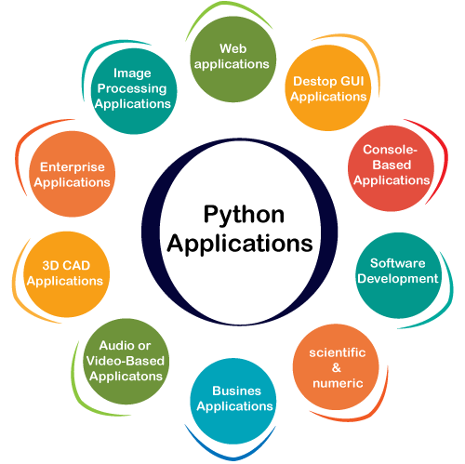
Applications
https://www.javatpoint.com/python-applications

Slide 9
Issues
Speed : Slow speed due to interpreted language
Not suitable for Mobile Development
Memory Consumption: Due to dynamic typing takes more memory for providing flexibility
Database Access: Primitive and underdeveloped structure compared to ODBC or JDBC. Not good to handle complex legacy data in enterprise applications
Runtime Errors: Requires more testing and has errors that only show up at runtime because of dynamically typed.
https://www.geeksforgeeks.org/disadvantages-of-python/

Slide 10
Downloading, Installing and configuring Python on Windows

Slide 11
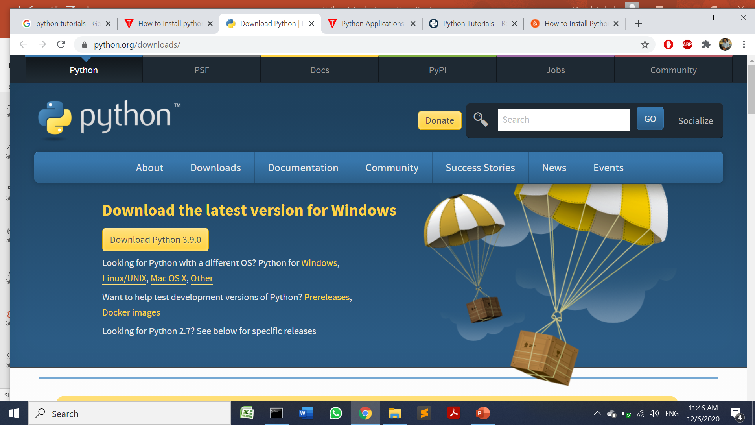
Download

Slide 12
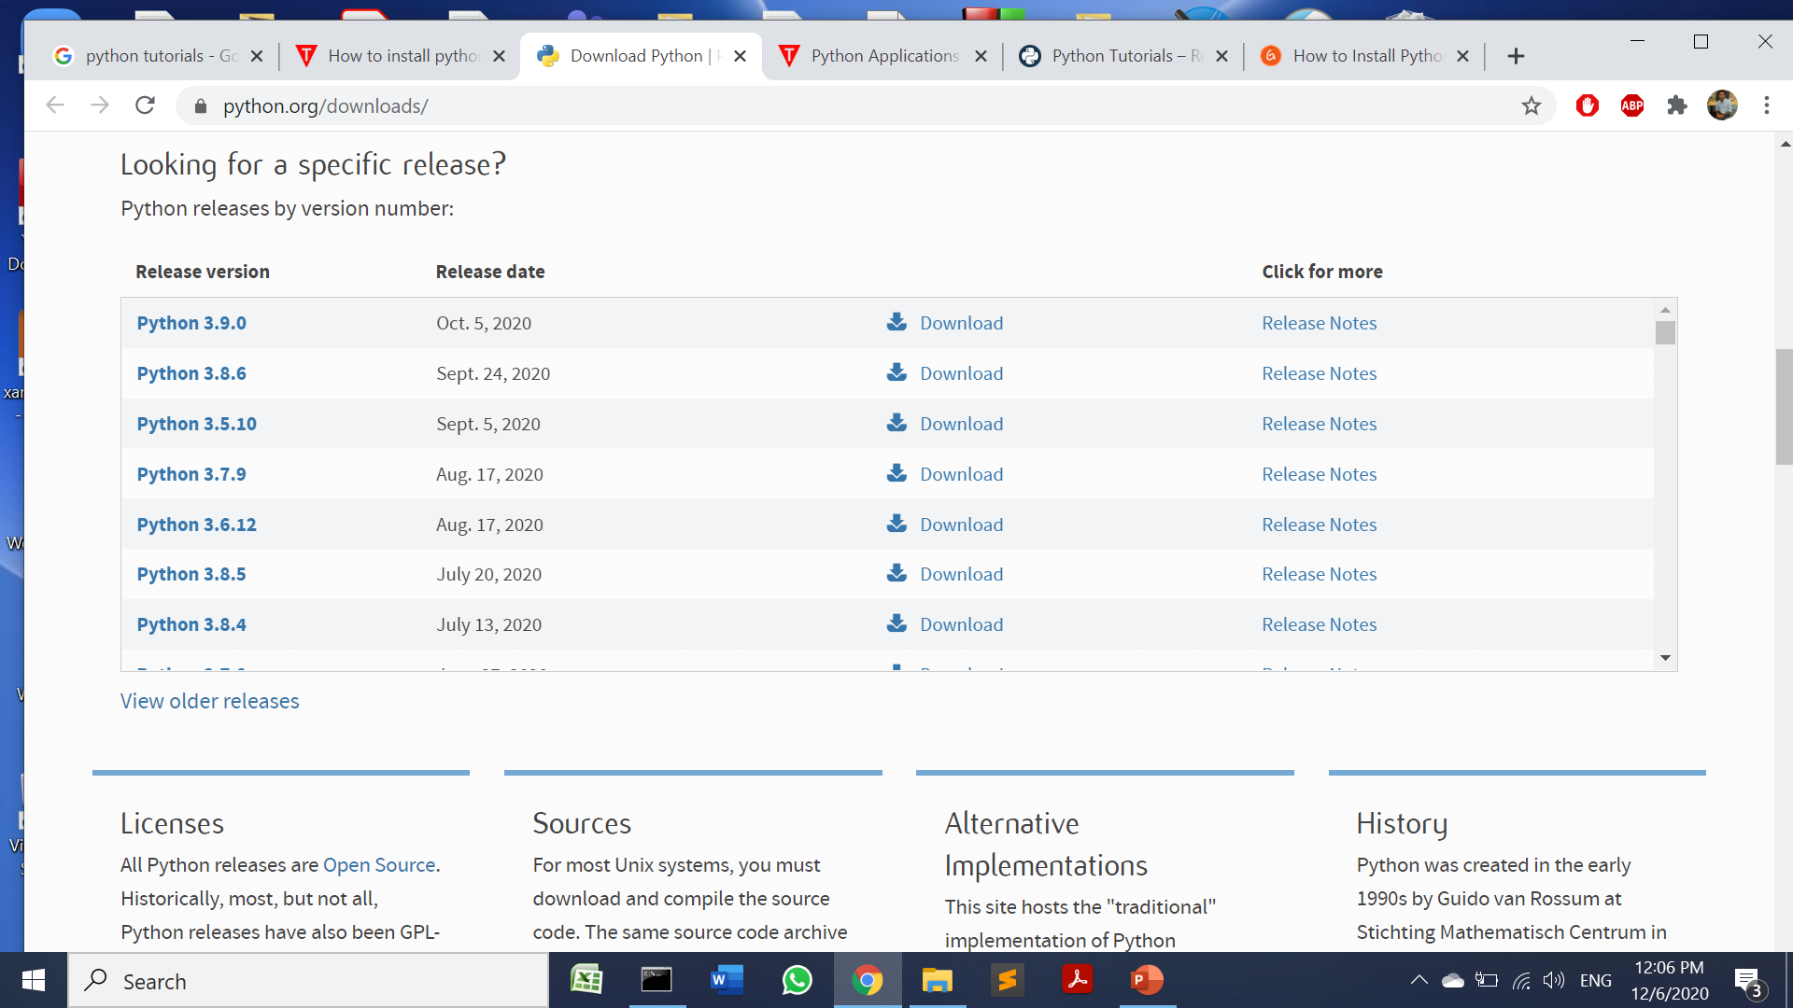
Download

Slide 13
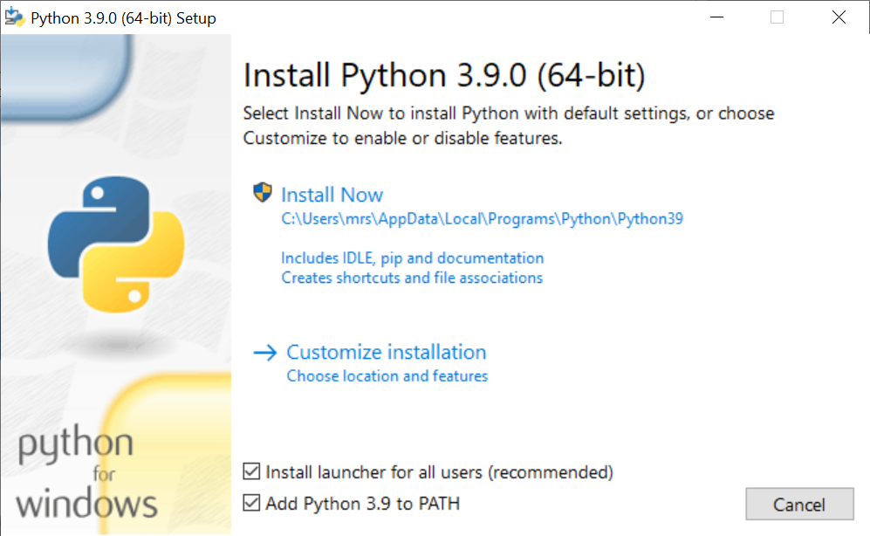
Installation

Slide 14
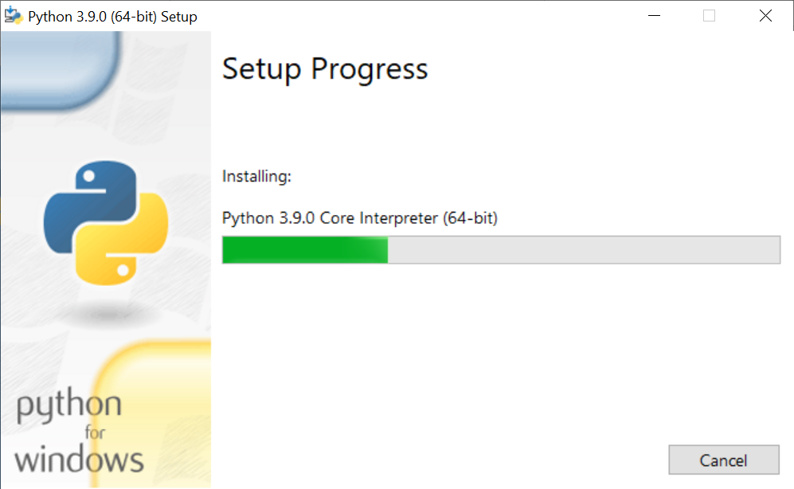
Installation

Slide 15
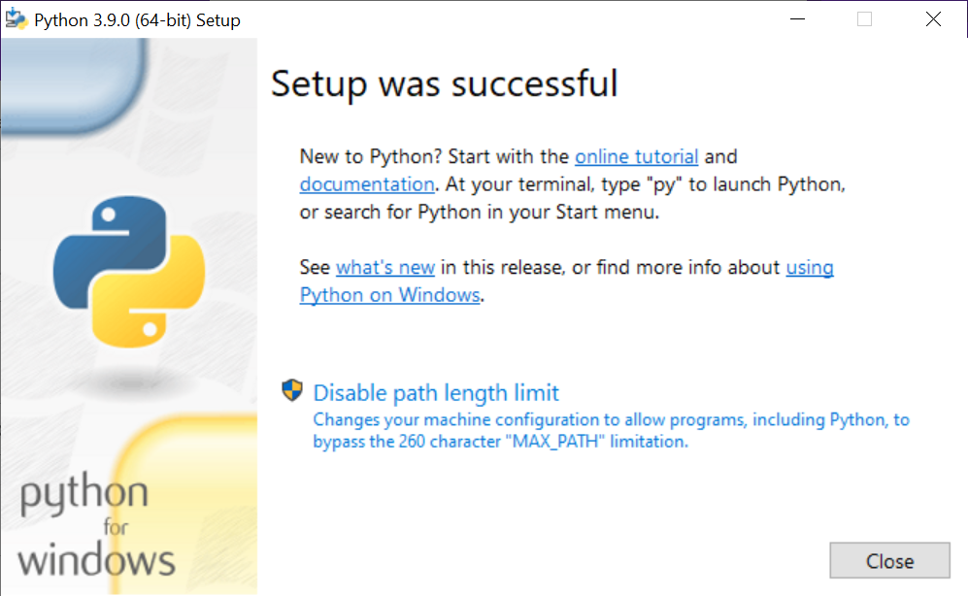
Installation

Slide 16
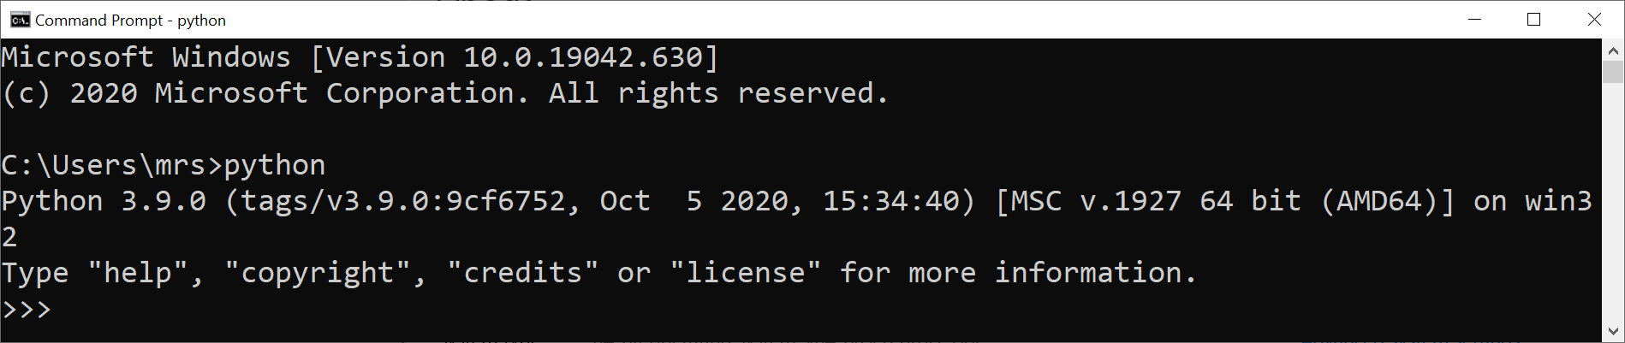
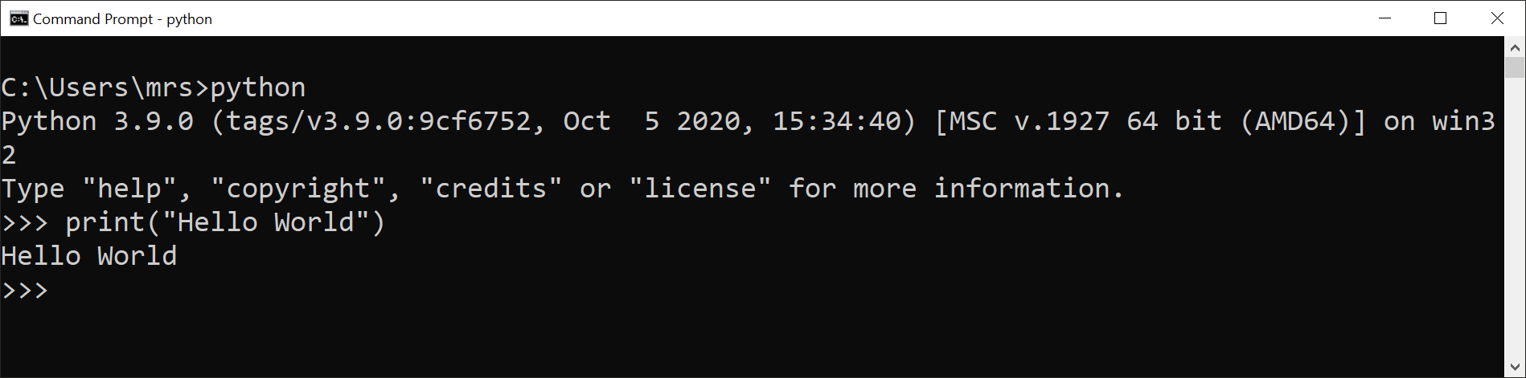
Hello World Program on Shell

Slide 17
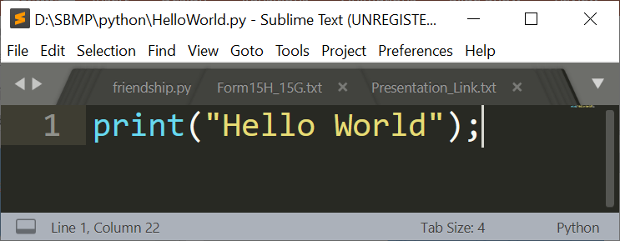
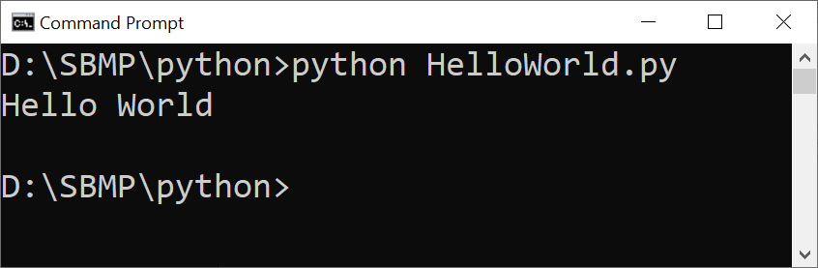
Hello World Program on Sublime Text

Slide 18
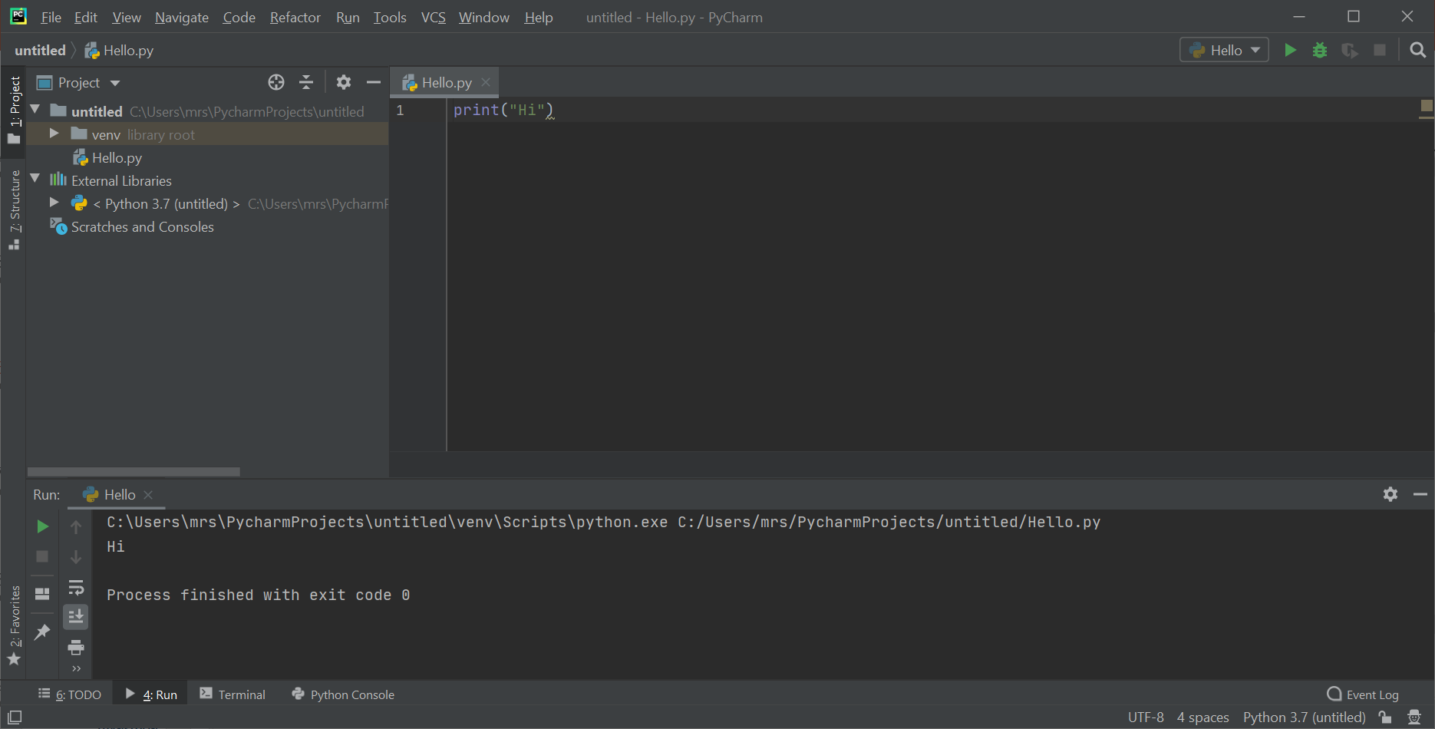
Hello World Program on PyCharm

Slide 19
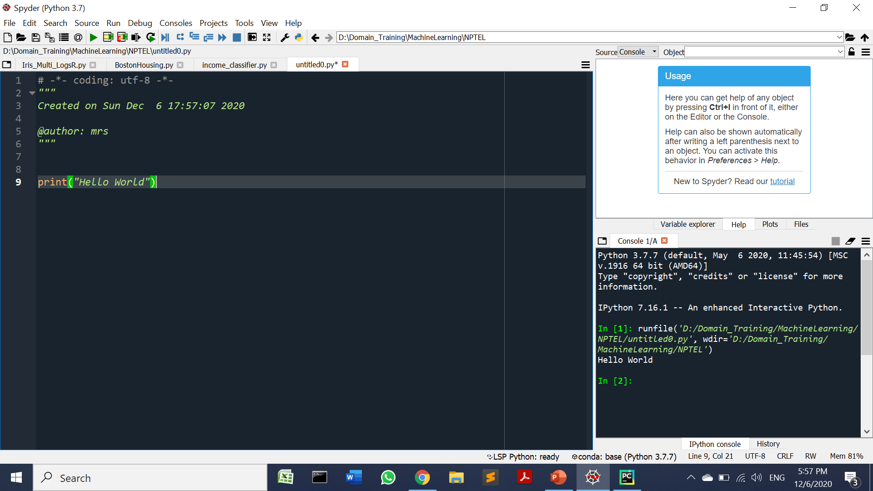
Hello World Program on Spyder

Slide 20
Is Python Compiled or Interpreted?
When we type Python command with .py file on Command Prompt. Basically Python is being compiled into bytecode and this byte code is internally interpreted by Python virtual machine. (Like JVM)
The bytecode is generated temporarily so it is not explicitly created like .class file in Java.
If we want to create bytecode then write the following command:
python -m py_compile hello.py
It will create a directory named “__pycache__” and the bytecode with extension “.pyc” is generated in this directory.
To execute the program, go inside bytecode directory and type “python hello.cpython-39.pyc” command.

Slide 21
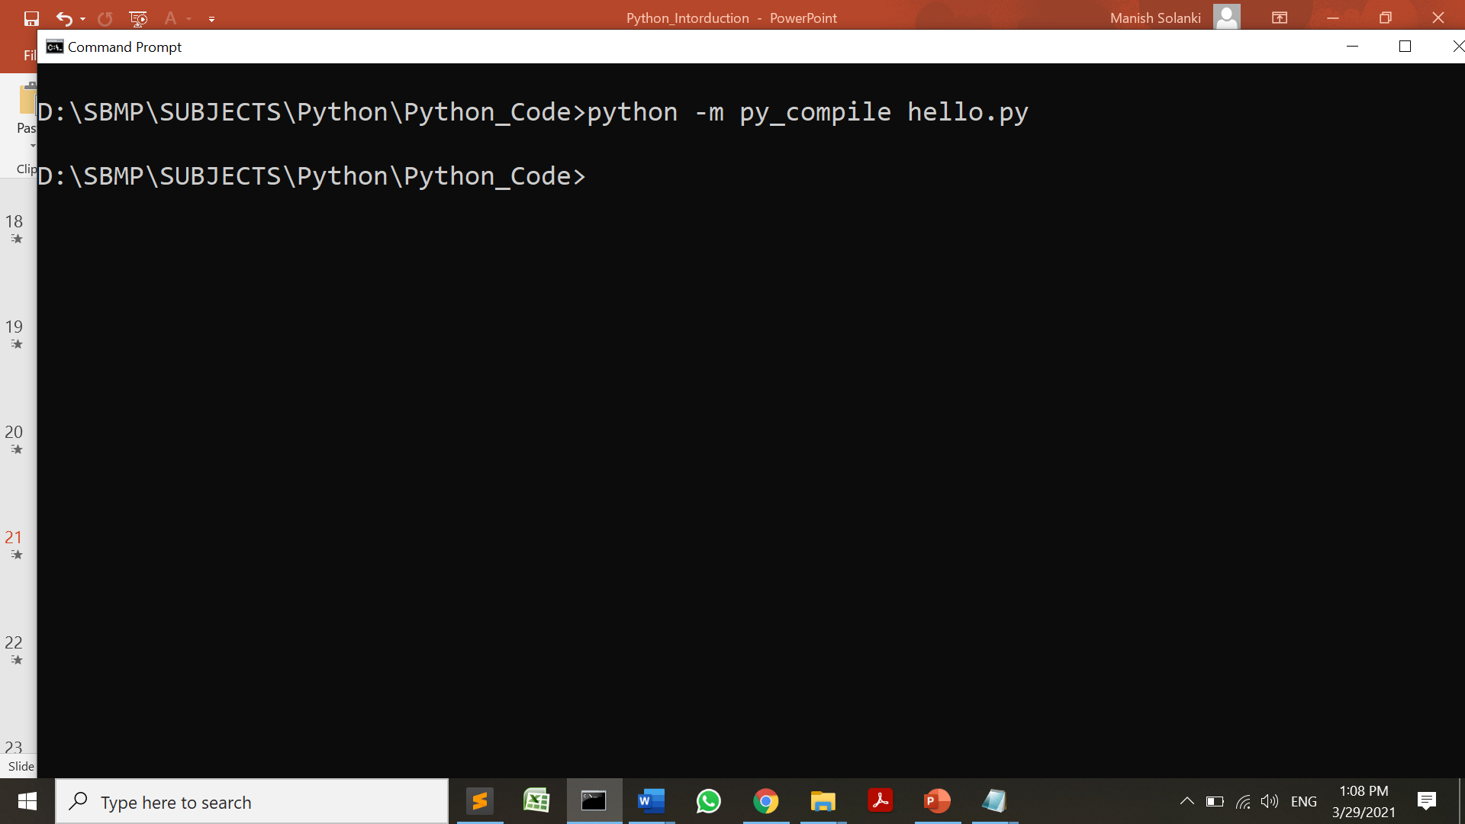
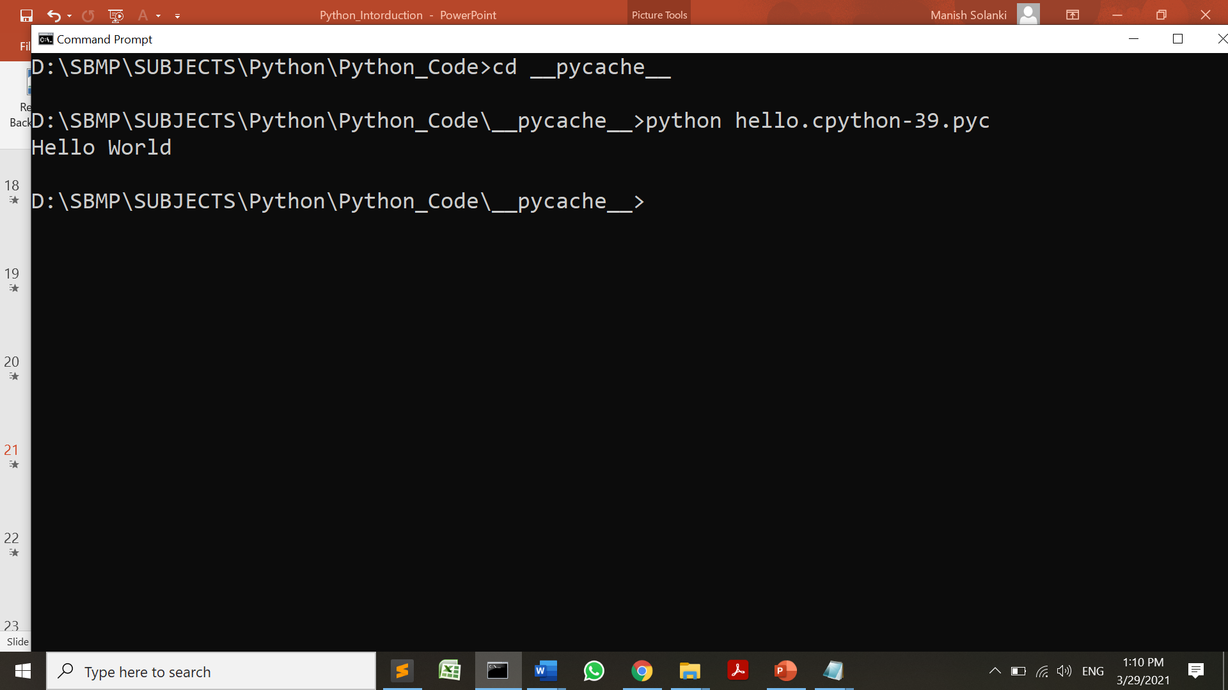
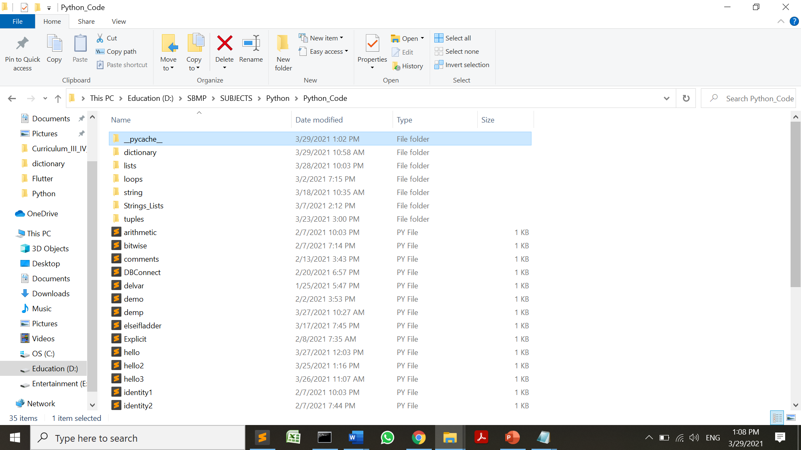
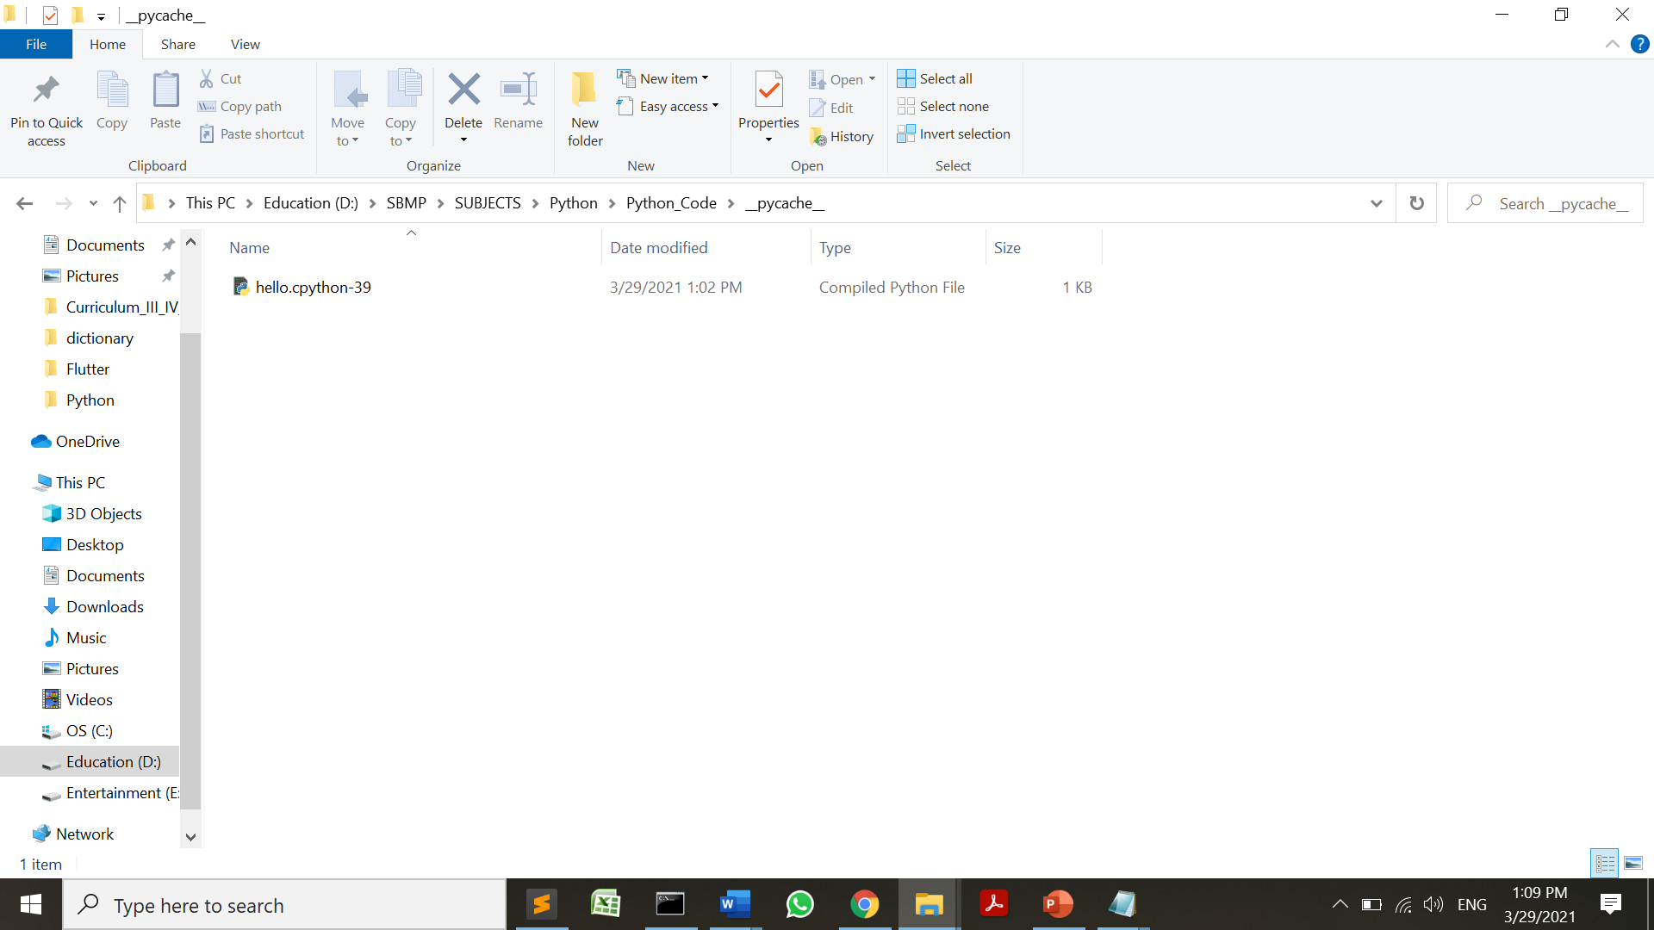
Is Python Compiled or Interpreted?

Slide 22
#Whenever a Python program is called, Python will check, if a compiled version with the .pyc suffix exists and has newer than the file with the .py. If such a file exists, Python will load the byte code. #If byte code is not present, Python will create the byte code before it starts the execution of the program. #Execution of a Python program means execution of the byte code on the Python Virtual Machine (PVM).

Slide 23
PIP
PIP is a package management system used to install and manage software packages written in Python. It stands for “preferred installer program” or “Pip Installs Packages.”
When we install pip, it is added to the system as a command line program which can be run from the command line.
We use pip to install and uninstall Python packages.

Slide 24
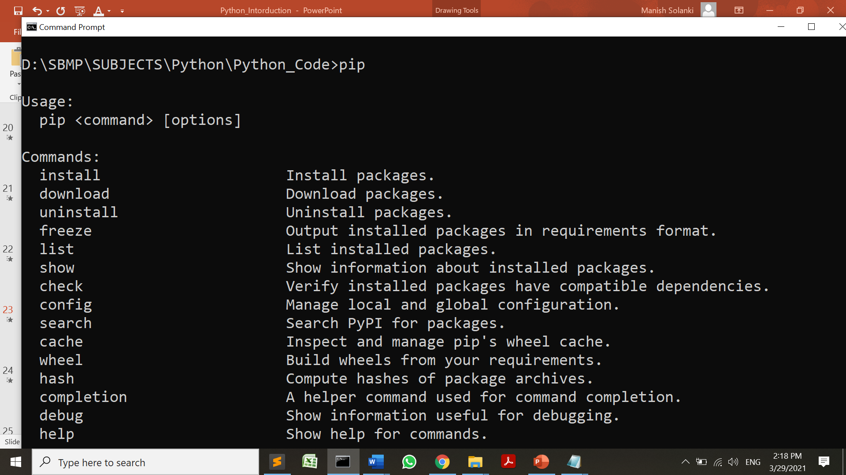
PIP
Installation of PIP : Check if PIP is Already Installed
Before you install PIP on Windows, check if PIP is already installed.
Type in the following command at the command prompt: pip or pip help

Slide 25
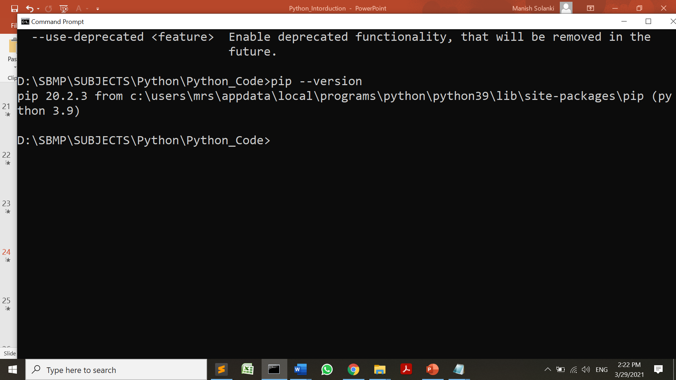
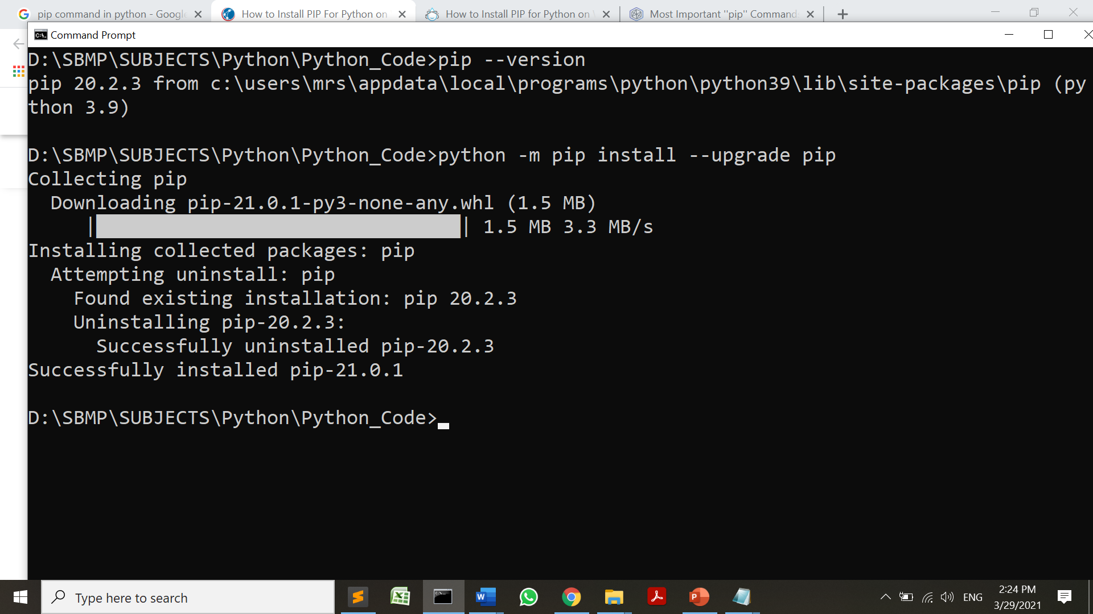
PIP
Getting PIP version
Upgrading PIP version

Slide 26
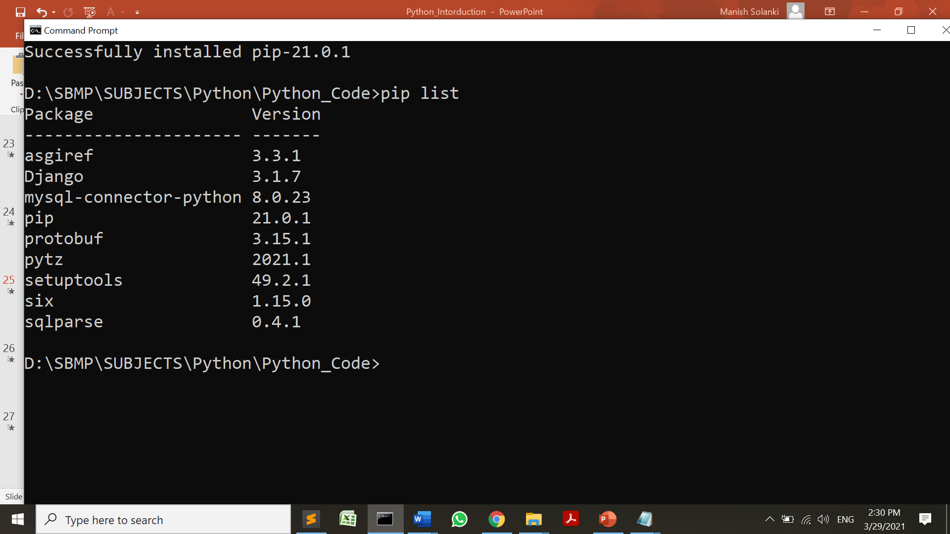
PIP
Downgrading PIP version: python -m pip install pip==18.1
Displayig list of packages: pip list

Slide 27
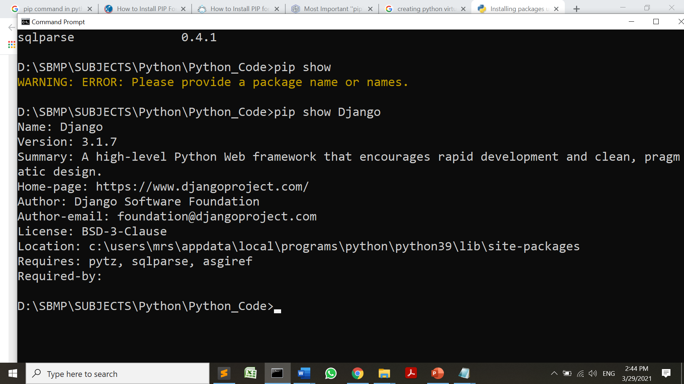
PIP
Showing description of a package: python show package-name

Slide 28
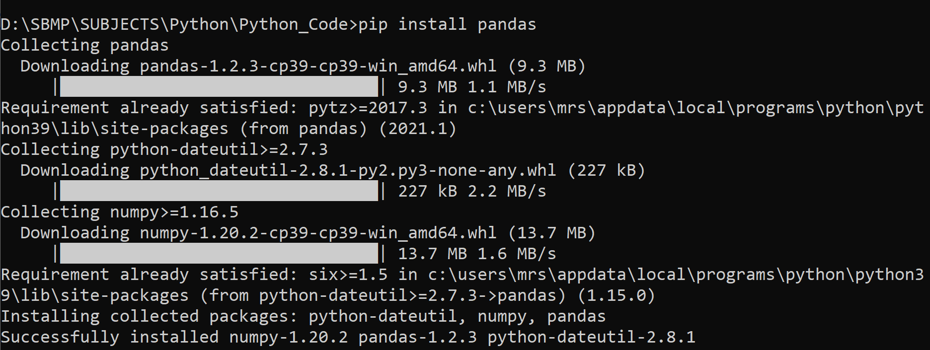
PIP
Installation of a package: python install package-name
Uninstallation of a package: python uninstall package-name

Slide 29
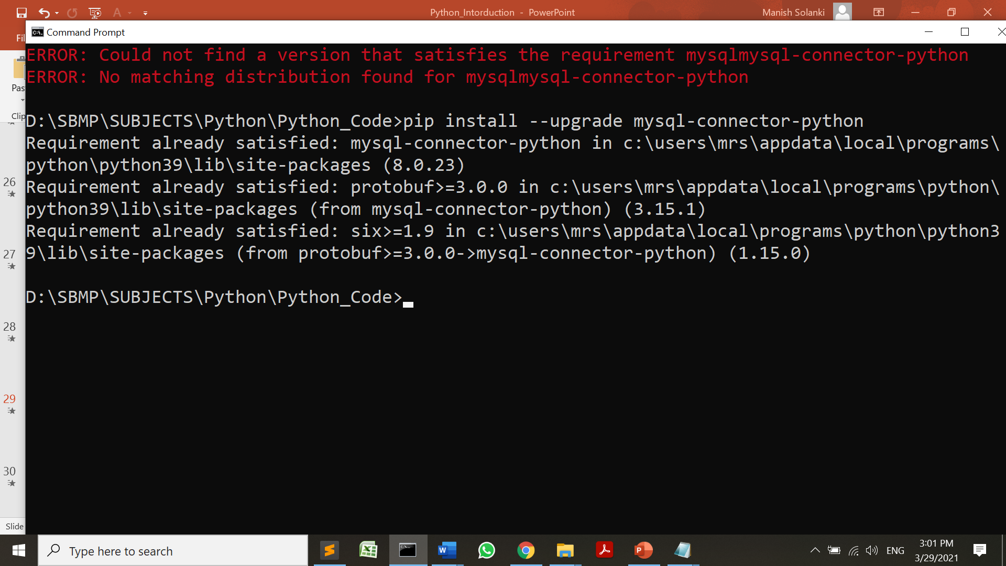
PIP
Upgrading a package: pip install --upgrade PackageName

Slide 30
References
https://www.javatpoint.com/python-tutorial
https://www.geeksforgeeks.org/disadvantages-of-python/

Slide 31
THANKS!
Any questions?
You can find me at
manish_ratilal2002@yahoo.com

